Slide 1
Breakout Ball Game
Humanshu Arora – Map Generator
Vatsal Savaliya – Logic of Gameplay
Nischal Goyal – Graphics and Fonts
Abhiuday – Main program
Abhishek Kumar – Presentation and overview

Slide 2
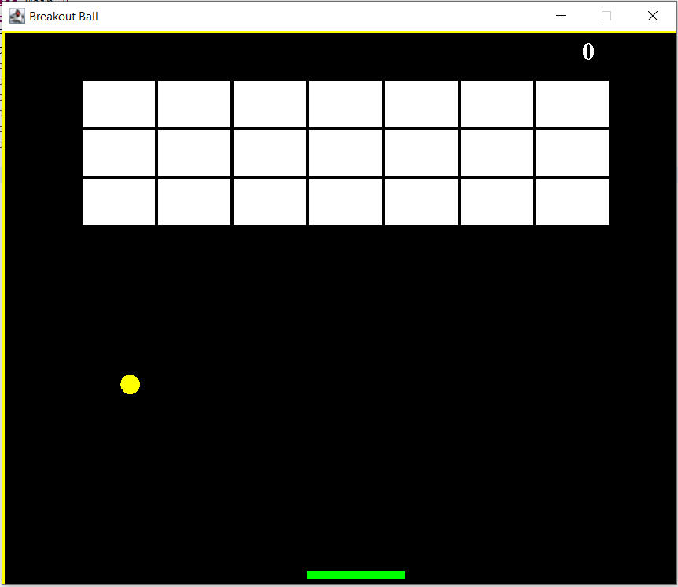
Objective
To Create Breakout Ball Game
In this game a layer of bricks lines the top third of the screen and our objective is to destroy them all using a ball and a movable paddle.
The paddle moves horizontally across the screen to prevent ball from falling downwards
The goal is to destroy all the bricks using the ball and paddle

Slide 3
Approach
Design the window where the game needs to be framed.
Design the entire gameplay (background, bricks, ball, paddle).
Implement the actions of the keys (to move the paddle sideways).
Implement the action performed by the ball on the bricks and paddle.

Slide 4
Goals
The player should be able to start the game in the terminal by pressing the ENTER key.
The player should be able to move the paddle sideways using the Leftwards and the Rightwards Arrow on the keyboard.
Once the player loses the ball, i.e. when the ball touches the bottom of the screen, the game ends.
Breaking each brick should provide the player a certain number of points. Let's say each brick contains 5 points, if a player breaks 10 such bricks, he gets 50 points.
Once the game ends, the terminal will present the final score of the player and give him the option to restart the game again.

Slide 5
Creating The Game
First we need to set up the development environment for the Java GUI project. For this, we need to install Java 8 or higher. Additionally we need a code-editor or IDE to write the code.
We will be using eclipse IDE to write the code.

Slide 6
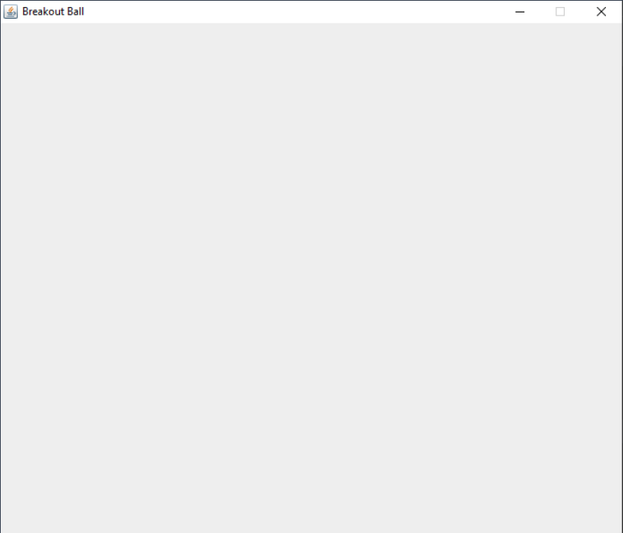
Design the Game terminal
Game terminal is the window where the game is to be played. It consists of the following aspects:
Window size (length, breadth and height)
Window visibility
Game title
Default close operation
Requirements
Create a Main class inside the base package
Import Java Swing dependency
Create a JFrame object to implement the GUI functionality
Design the window terminal by writing the code

Slide 7
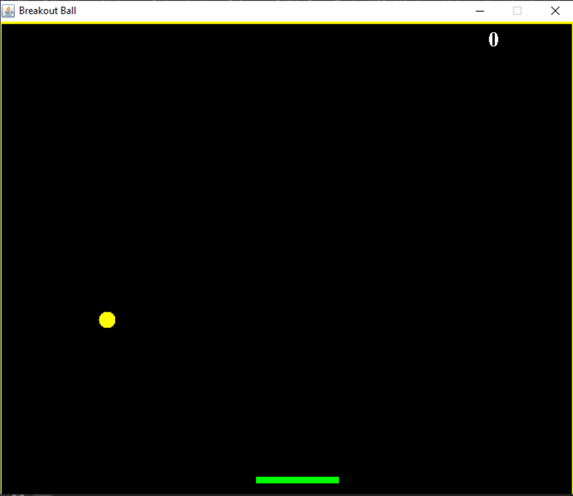
Design the Gameplay
Create a Gameplay class inside the base package
Import Java AWT and Swing dependencies
Extend the JPanel container class by implementing KeyListner and ActionListner interfaces. Check out more on these classes and interfaces:
Design the background template
Implement the code for ball positioning
Implement the code for moving the paddle using KeyEvent and ActionEvent

Slide 8
Design the bricks using 2D array
Create a Map Generator class inside the base package
Import Java AWT dependency
Design the bricks
Implement the code for the bricks to disappear once the ball hits
Implement the code for calculating the score in the 'Gameplay' class

Slide 9
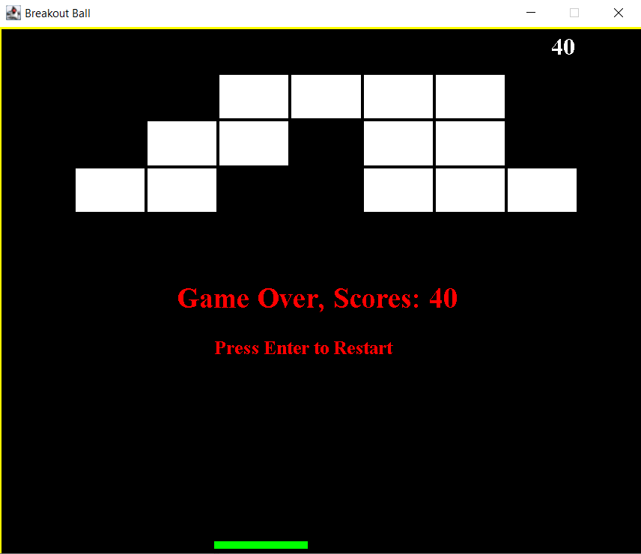
Run the game in the terminal
Build the project
Import any dependencies, if left
Run the Main() class
Play the game in the terminal

